Slide 1
WASTE MISMANAGEMENT
smart solutions for cleaner communities
307-109

Slide 2
project team
this project was developed by :
Yousef Osman
Ammar Ali
Remas Balboul
Rawan Yakoot
Hana shamso
under supervised by: Eng. Alaa Mohamed zahra

Slide 3
The Problem
Waste mismanagement remains a serious challenge in urban areas.
Many residents dispose of waste improperly due to:
Lack of awareness
No clear information about nearby waste bins
Weak reporting systems
Slow response from authorities
This leads to polluted streets, health risks, and a negative impact on community life.
Notes:
ouklñ

Slide 4
The Idea Solution
We propose a mobile application that:
Shows nearby garbage bins on an interactive map
Allows users to report dirty areas by uploading photos
Divides the city into small squares
Turns reported areas RED
Turns them GREEN after cleaning
Rewards users with points or discount coupons

Slide 5

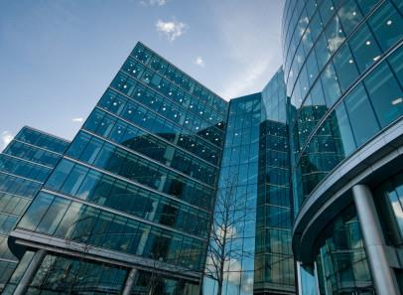





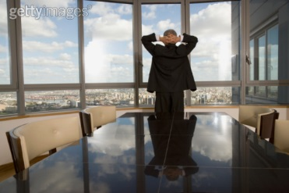




Sustainable Development Goals (SDGs) Related to the Project
Goal 8 – Decent Work and Economic Growth: Create green jobs via recycling.
Goal 3 – Good Health and Well-being: Reduce pollution for healthier communities.
Goal 6 – Clean Water and Sanitation: Protect water sources from contamination.
Goal 7 – Affordable and Clean Energy: Cut waste burning to lower pollution.
Goal 4 – Quality Education: Teach proper waste habits in schools.
Goal 9 – Industry, Innovation and Infrastructure: Use innovative waste solutions.

Slide 6






Sustainable Development Goals (SDGs) Related to the Project
Goal 11 – Sustainable Cities and Communities: Promote cleaner urban environments.
Goal 13 – Climate Action: Reduce greenhouse gas emissions from waste.
Goal 15 – Life on Land: Protect ecosystems through proper disposal.
Goal 12 – Responsible Consumption and Production: Encourage recycling and proper handling.
Goal 14 – Life Below Water: Prevent waste from reaching waterways.
Goal 17 – Partnerships for the Goals: Collaborate for sustainable waste solutions.

Slide 7
Target Users
Our target users are:
People who live in cities
Young people and students
Local community member
City authorities
Notes:
ouklñ

Slide 8
Empathy Map
Users Say:
Users Do:
“There is too much garbage in my area.”
“No one responds when we complain.”
1
2
Avoid dirty areas.
Complain on social media.
Ignore the problem due to lack of clear solutions.
Users Think:
Users See:
“The government should fix this.”
“My participation will not make a difference.”
3
4
Dirty streets.
Overflowing garbage bins.
Slow response from cleaning services.
Gains
Pains
Living in unhealthy and polluted environments
Clean and safe neighborhoods
Fast response and visible results
Feeling valued and involved in community improvement
Earning rewards through active participation
Lack of transparency in cleaning processes
Feeling unheard and powerless
No incentive to report problems

Slide 9
Prior Solutions
Some similar initiatives have been tried before, such as:
Dawar App in Egypt, which allows users to report waste using photos and GPS
National waste management programs focused on awareness and system improvement
However, most existing solutions focus only on reporting, while our solution combines reporting, visual tracking, and user incentives.
Notes:
ouklñ

Slide 10
Design requirement
functional design requirement
Non-functional design requirement
User registration and login
User-friendly interface
Interactive map
Fast performance
Photo upload with location detection
Secure data handling
Red/Green status update system
High system reliability
Points and rewards system
scalability for future expansion
Admin deshboard for authorities

Slide 11
THANK YOU
smart solutions for cleaner communities
307-109

